Slide 1
Animal Management

Slide 2
Aims of Castration
1-Growth rate in steer (teaser) is higher than the bulls.
2-The steer is calm than in bulls.
3-The flavour of meat in steers are more best than the bulls.
3-To detect the caws during estrous period but cannot fertilized.

Slide 3
Methods of Castration
1-Burdizo system.
2-Rubber band.
3-Surgical method.

Slide 4
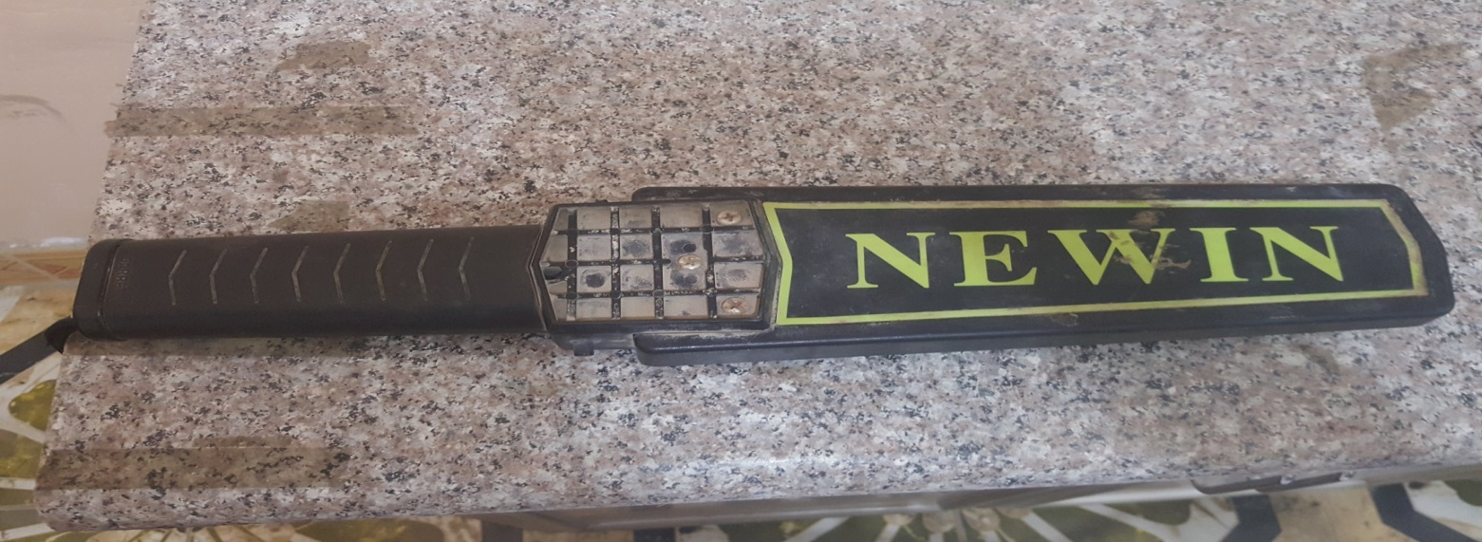
Metal Detector
Aim: To detect the foreign body in rumen.

Slide 5
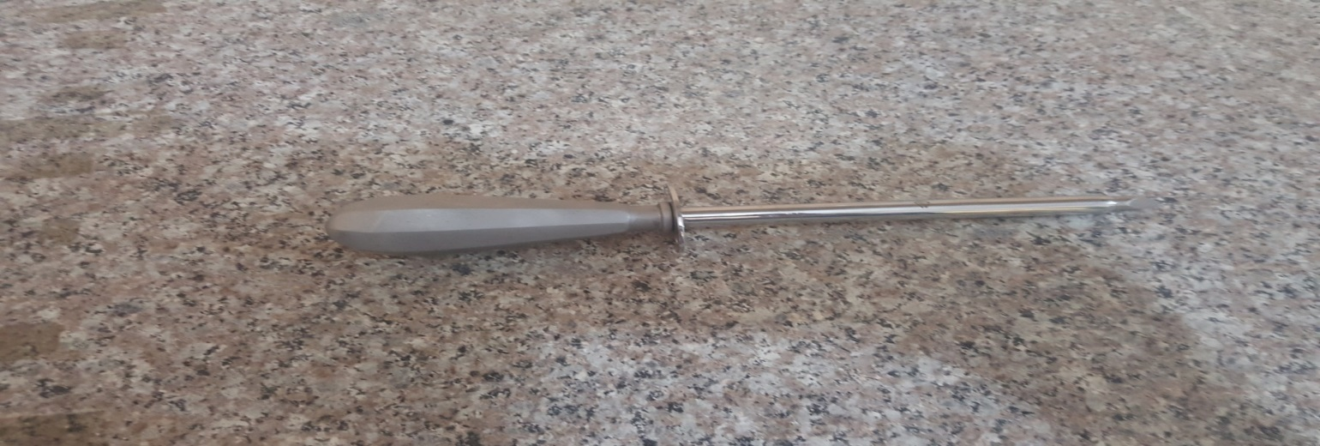
Trocar Canulla
Aim: To detect exit the frothy and free gases from rumen.

Slide 6
Vaginal Speculum
Aims:
1-To detect the caw during estrous period.
2-For using artificial insemination for veterinary doctor.
3-To detect the parturition time.
4-To detect the normal and abnormal secretion of uterus.

Slide 7
Vaginal Speculum

Slide 8
Anti-Sucking Tool
Aim: To prevent the animal from lactation from himself.

Slide 9
Stomach Tube
Aims:
1-For drug administration.
2-For exit the gases.
3-To insure administration complete the drugs.

Slide 10
Stomach Tube

Slide 11
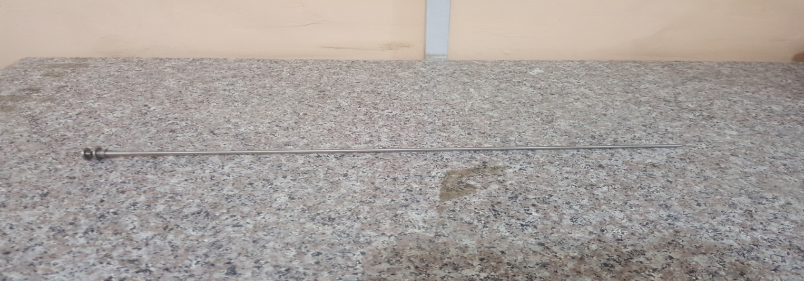
Artificial Insemination Gun
Aim: For fertilization cow during estrous time.

Slide 12
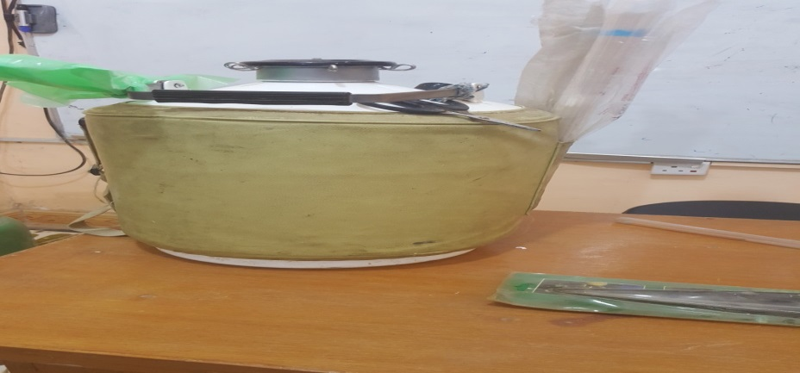
Artificial Insemination Bottle
Aim:
1-Storage the semen for long time.
2-Make the semen rest period.

